Slide 1

ROAD ACCIDENT ANALYSIS
BY
bee Team
KASTHURI R
MONIKA C
HARSHINI D
DHANUSH PRIYA RB

Slide 2

Problem statement
Develop a Road Accident Dashboard for 2021 and 2022. Highlight primary KPIs and include secondary KPIs by Accident impact. Provide clear Total Casualties and Total Accidents overview by Location, addressing client's need for insights into road accidents and trends.

Slide 3
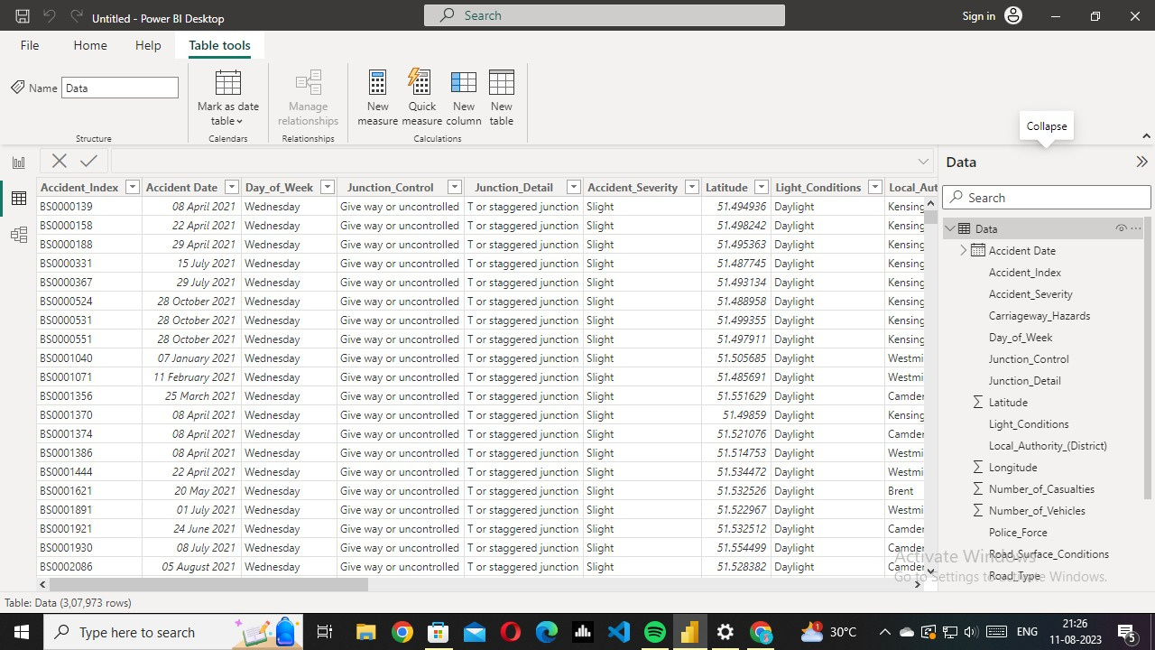
DATASET

Slide 4
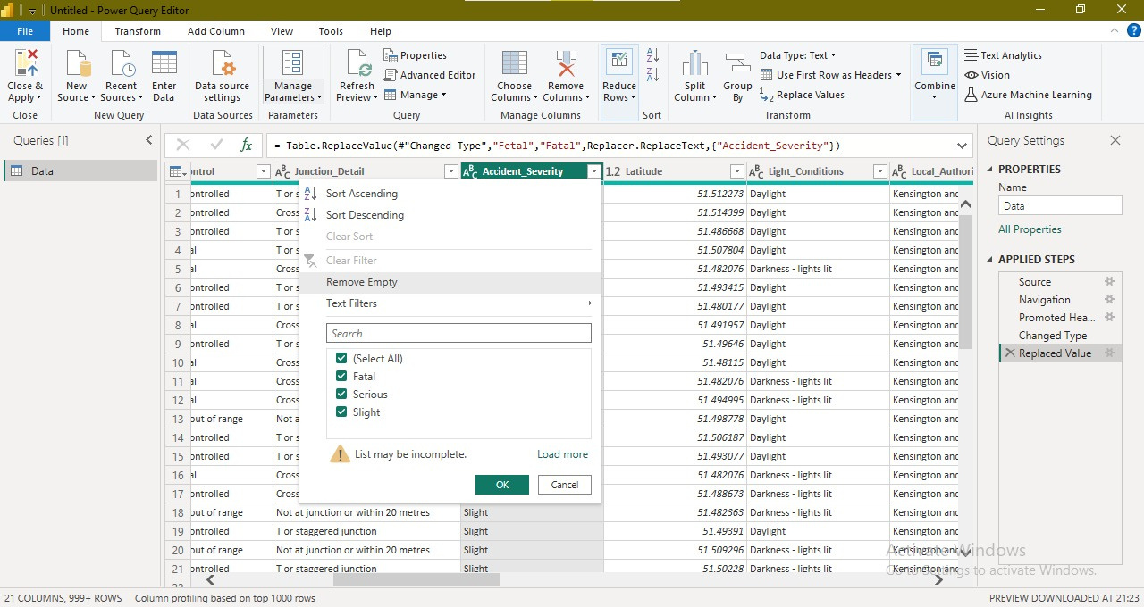
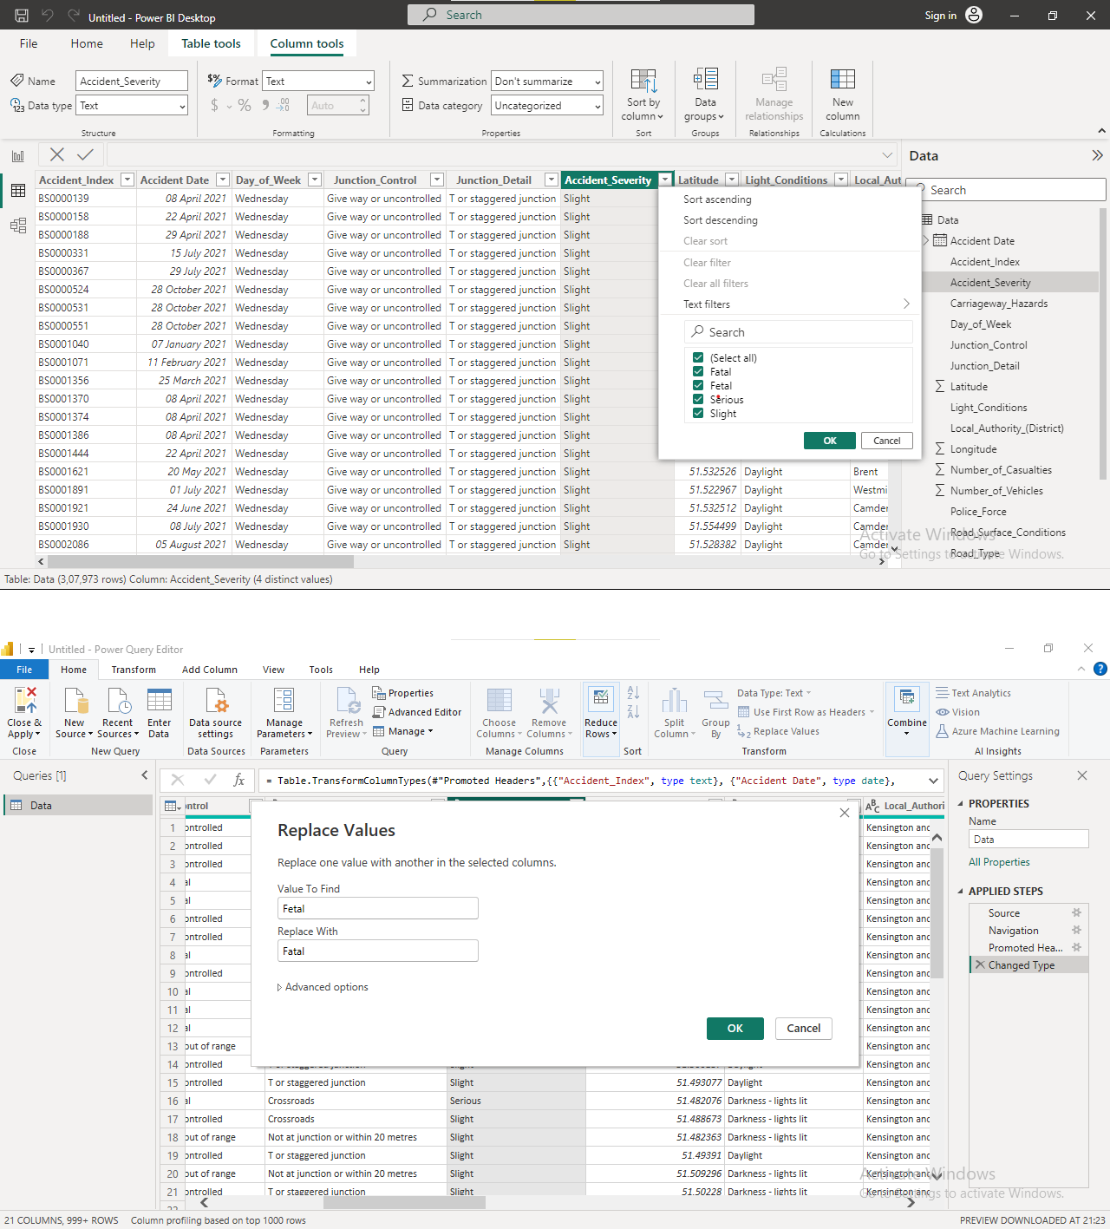
CLEAN DATASET
ISSUE

Slide 5

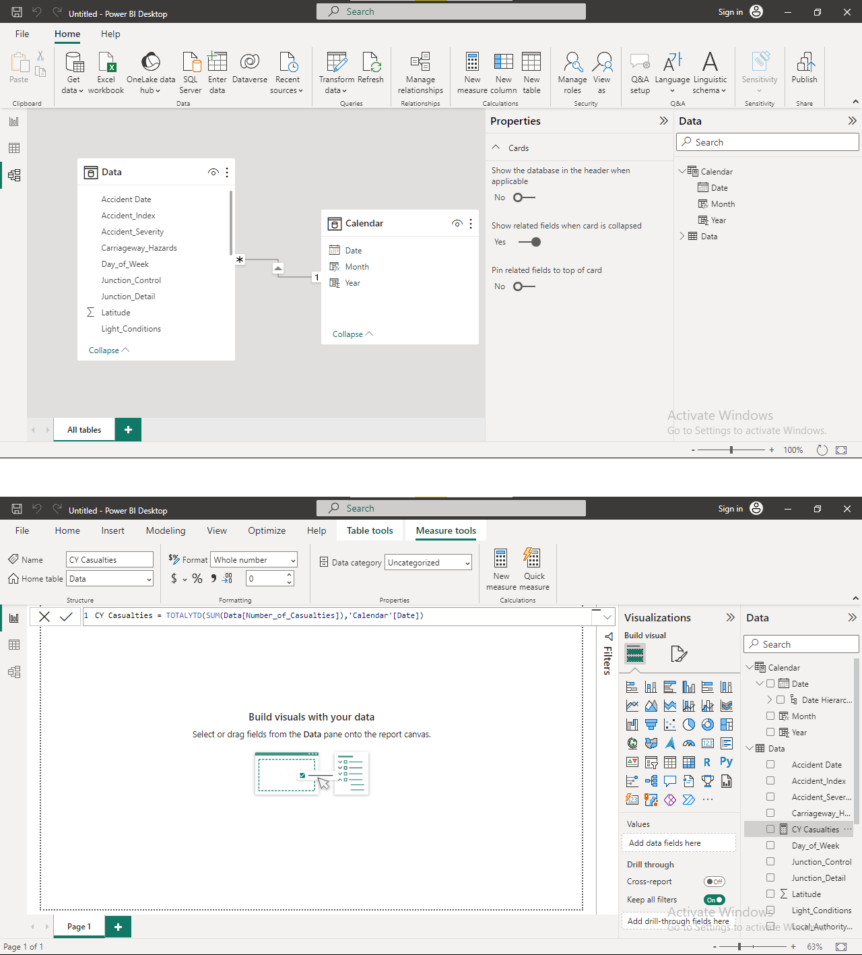
DAX EXPRESSIONS
DATA PROCESSING
Calendar = CALENDAR(MIN(Data[Accident Date]),MAX(Data[Accident Date]))
Year = YEAR('Calendar'[Date])
Month = FORMAT('Calendar'[Date],"mmm")
Month Number = MONTH('Calendar'[Date])
DATA MODELING

Slide 6
REPORT ANALYSIS
Primary KPI - Total Casualties and Total Accident values for Current Year and YoY growth
Primary KPI's - Total Casualties by Accident Severity for Current Year and YoY growth
Secondary KPI's - Total Casualties with respect to vehicle type for Current Year
Monthly trend showing comparison of casualties for Current Year and Previous Year
Casualties by Road Type for Current year
Current Year Casualties by Area/ Location & by Day/Night
Total Casualties and Total Accidents by Location

Slide 7

DAX EXPRESSIONS FOR REPORT
CY Casualties = TOTALYTD(SUM(Data[Number_of_Casualties]),'Calendar'[Date])
PY Casualties = CALCULATE(SUM(Data[Number_of_Casulaties]),SAMEPERIODLASTYEAR('Calendar'[Date]))
YoY Casualties = ([CY Casualties]-[PY Casualties])/PY Casualties]
CY Accident Count= TOTALYTD(COUNT(Date[Accident_Index]),'Calendar'[Date])
PY Accidents = CALCULATE(COUNT(Data[Accident_Index]),SAMEPERIODLASTYEAR('Calendar'[Date]))
YoY Accidents =([CY Accident Count]-[PY Accidents])/[PY Accidents]

Slide 8
SECURITY ROLE
Admin: Monika
Harshini - Hidden DATA
Kasthuri - HiddenACCIDENT_INDEX, ACCIDENT_DATE,
JUNCTION CONTROL
Dhanush Priya - Hidden CALENDER ,MONTH AND NUMBER

Slide 9
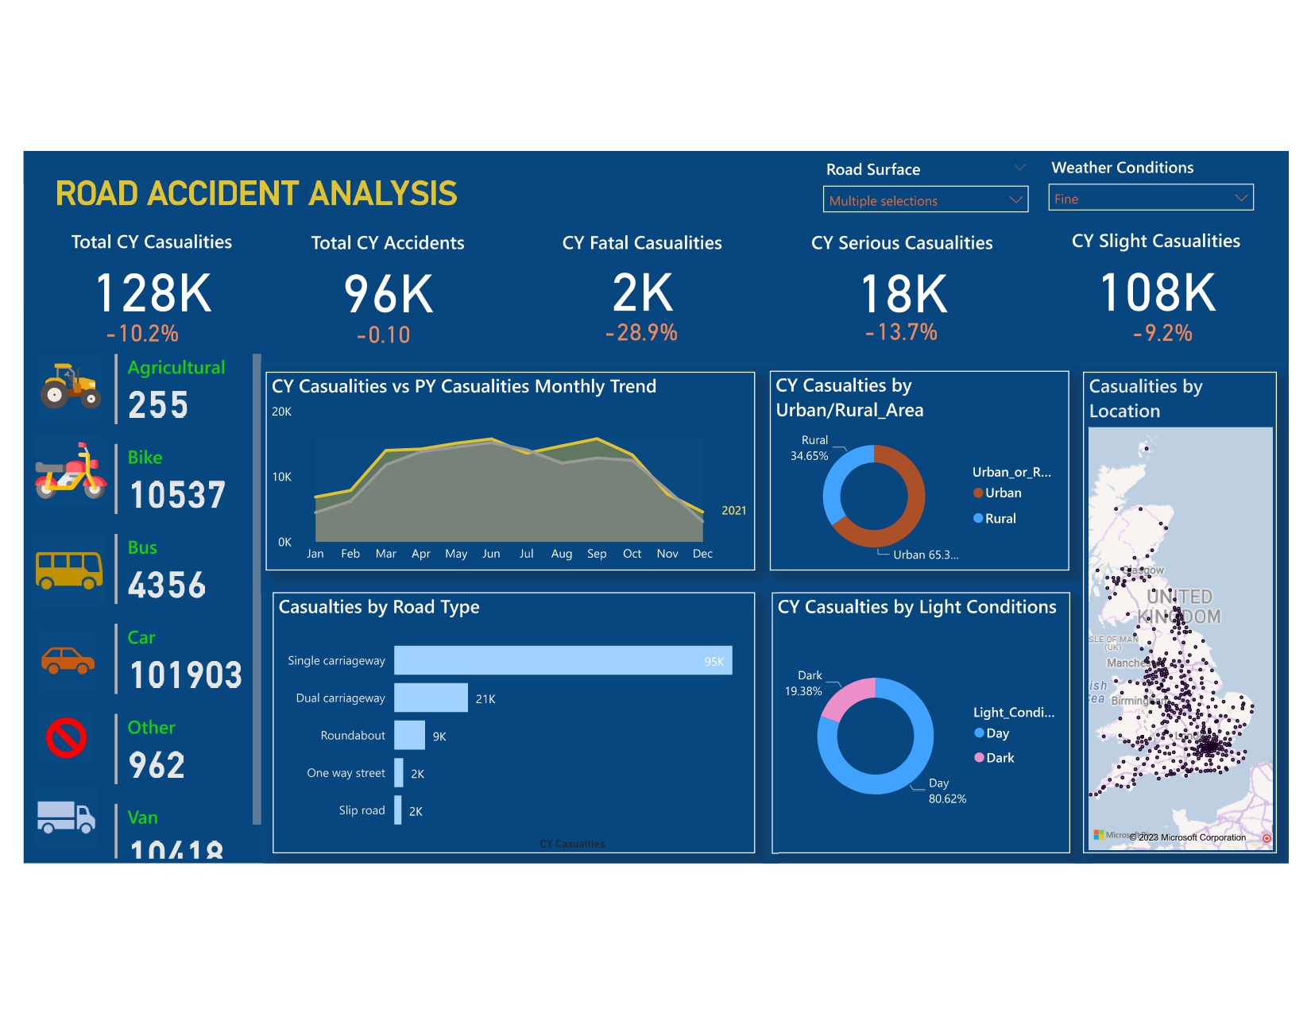
REPORT

Slide 10
THANK YOU

